Slide 1
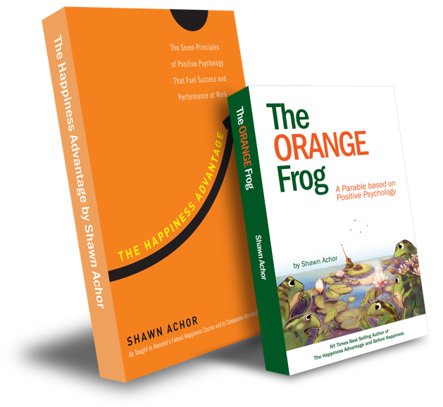
The Happiness Advantage
and
The Orange Frog
By Shawn Achor

Slide 2
Elementary Week Four

Slide 3

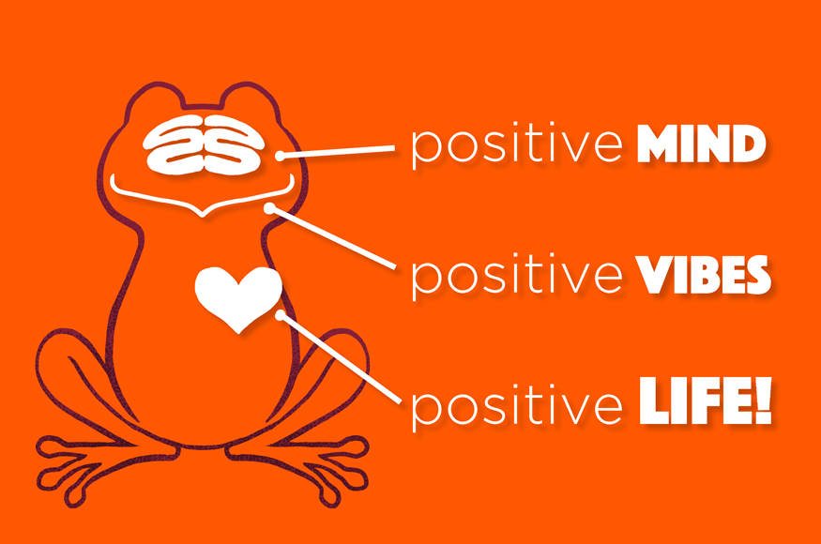
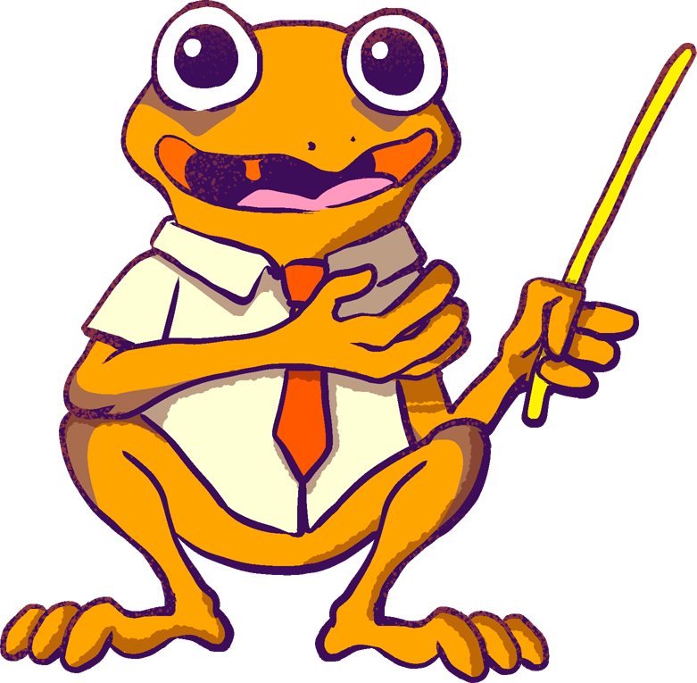
The Orange Frog
Learning Objective:
I can think and act like Spark
I will discuss what it means to handle situations like spark
Notes:
Standard:
Essential Concept and/or Skill: Communicate and work productively with others emphasizing collaboration and cultural awareness to produce quality work.
Interact positively as a team member.
Cooperate with others in a group setting.
Generate ideas with group members.
Are active listeners.
Read and understand information in a variety of forms.
Express ideas.
Skill:
Active listening, express ideas
Allow Spark to read pages 13-18 for the students or read to them.
https://www.orangefrogschools.com/elementary/ofkidsbook

Slide 4
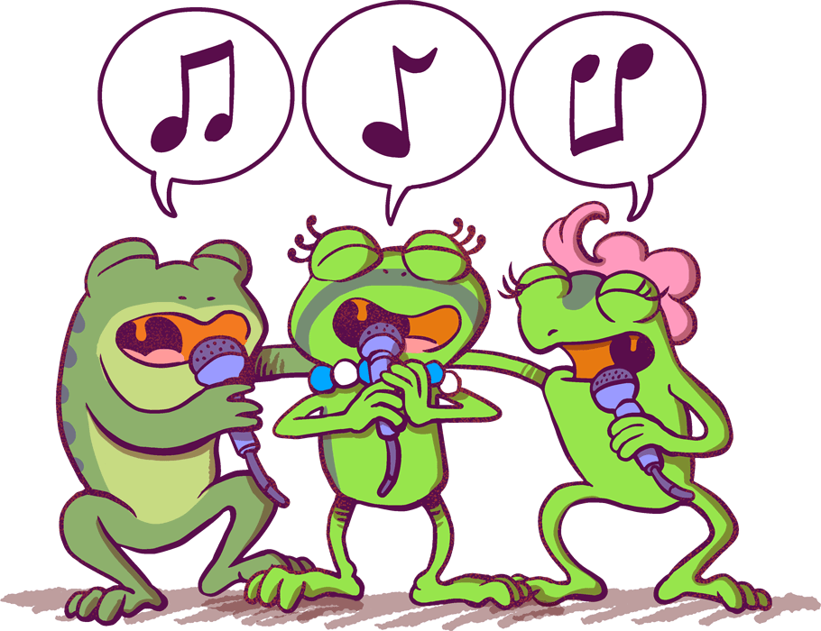
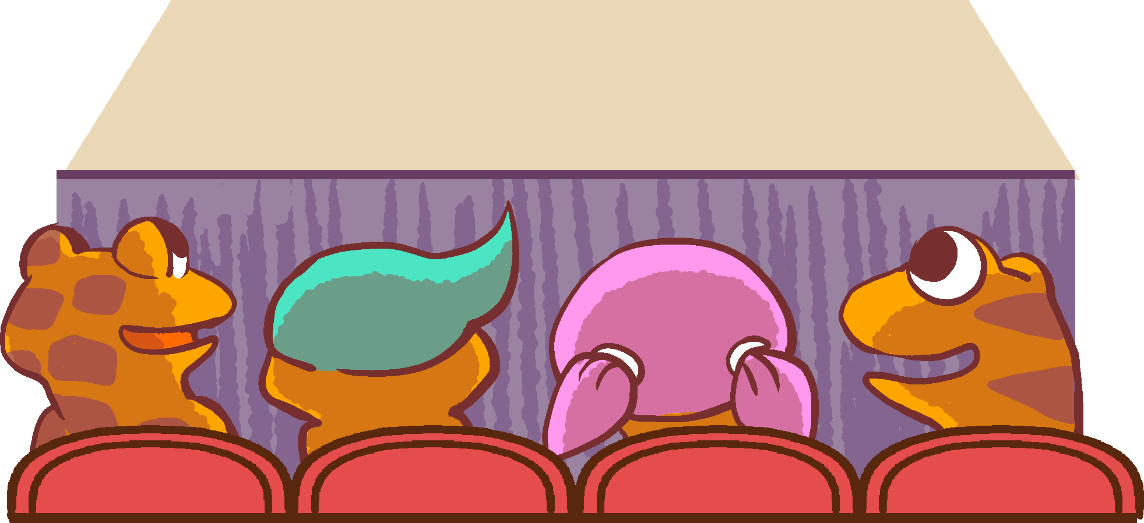
Skills
Interact positively as a team member.
Cooperate with others in a group setting.
Generate ideas with group members.
Are active listeners.
Read and understand information in a variety of forms.
Express ideas.

Slide 5
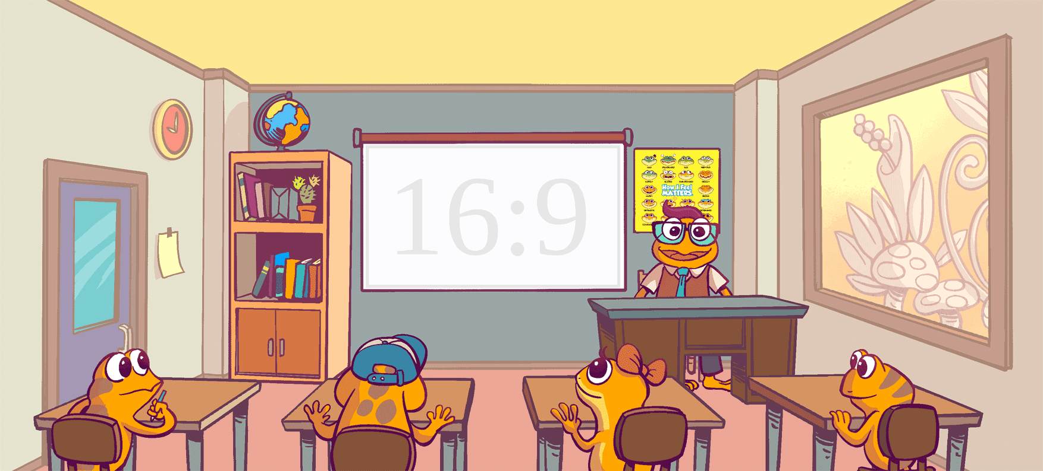
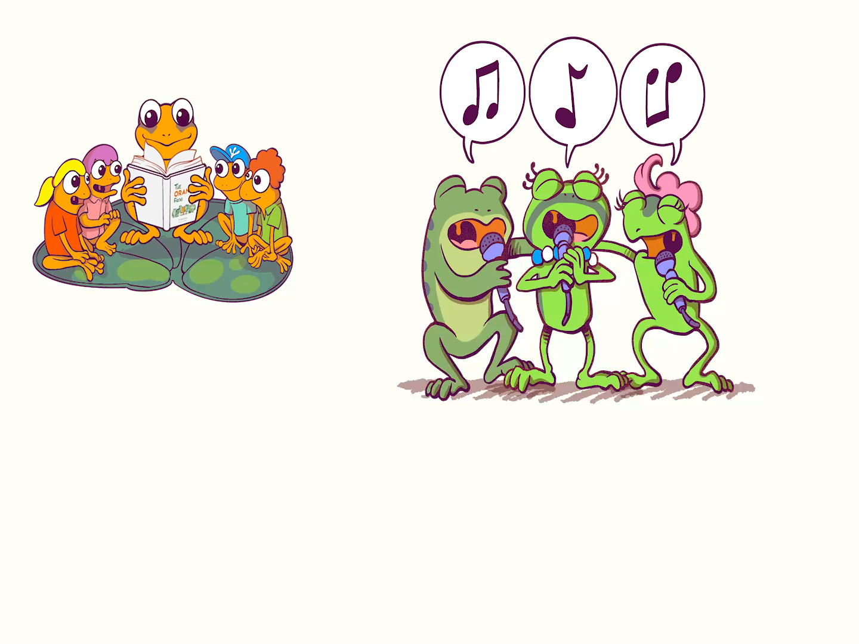
Week Four: Be Like Spark (pg. 19-25)
Notes:
Presenter Notes: Click forward to automatically play The Orange Frog Kid’s book. Click forward once more to view the video in full screen.

Slide 6
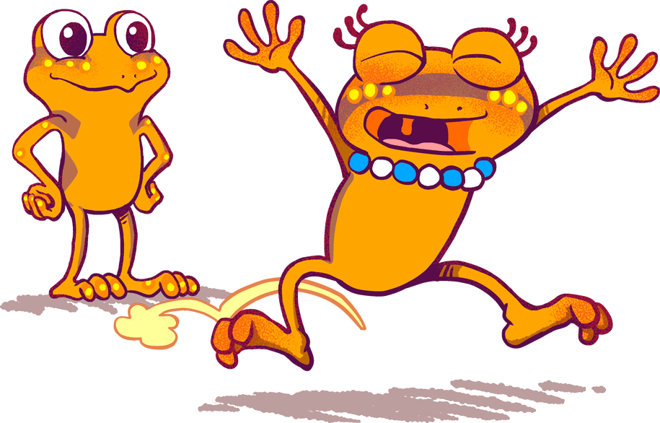
Thoughts
We begin today by learning that Misty has overcome her selfish ways. She notices that she has more and more Orange spots. Spark was thrilled to see her beautiful color. Spark also reflected and realized that everything he knew had changed. He was so much happier, and healthier. In the end, even Plop recognized that importance of being Orange.

Slide 7
Activity
Let’s take our SPARK acronym and associate the pictures to which category they belong to.

Slide 8

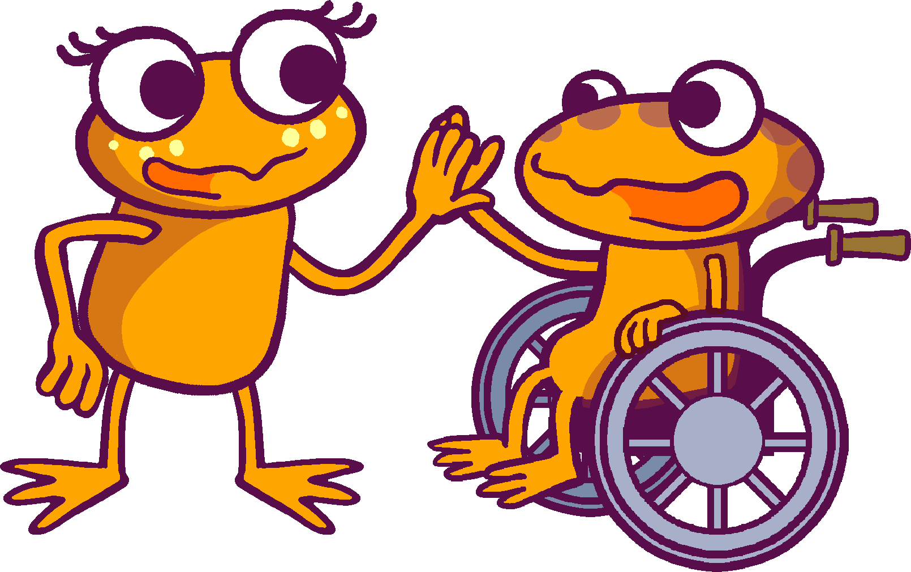

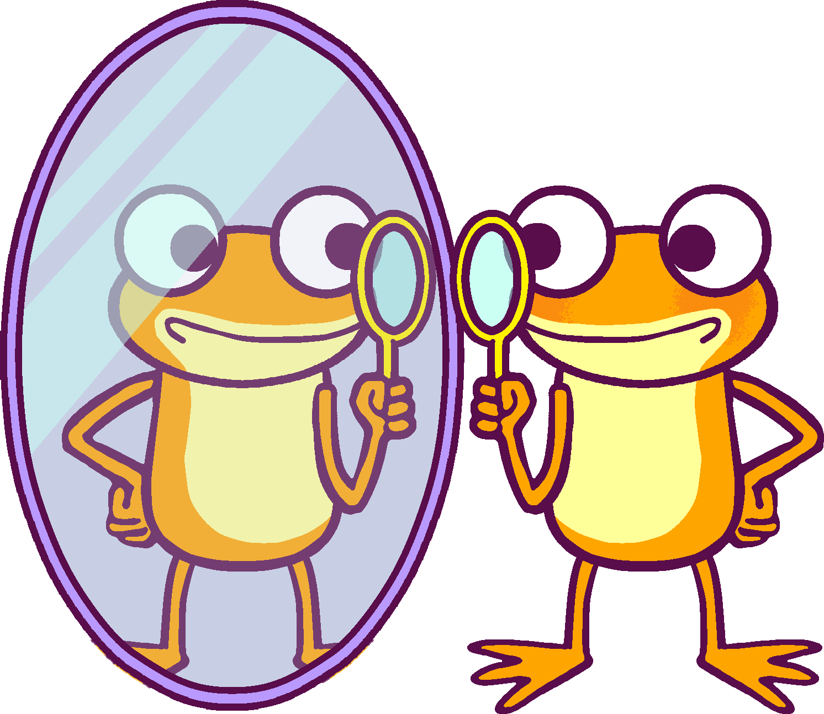

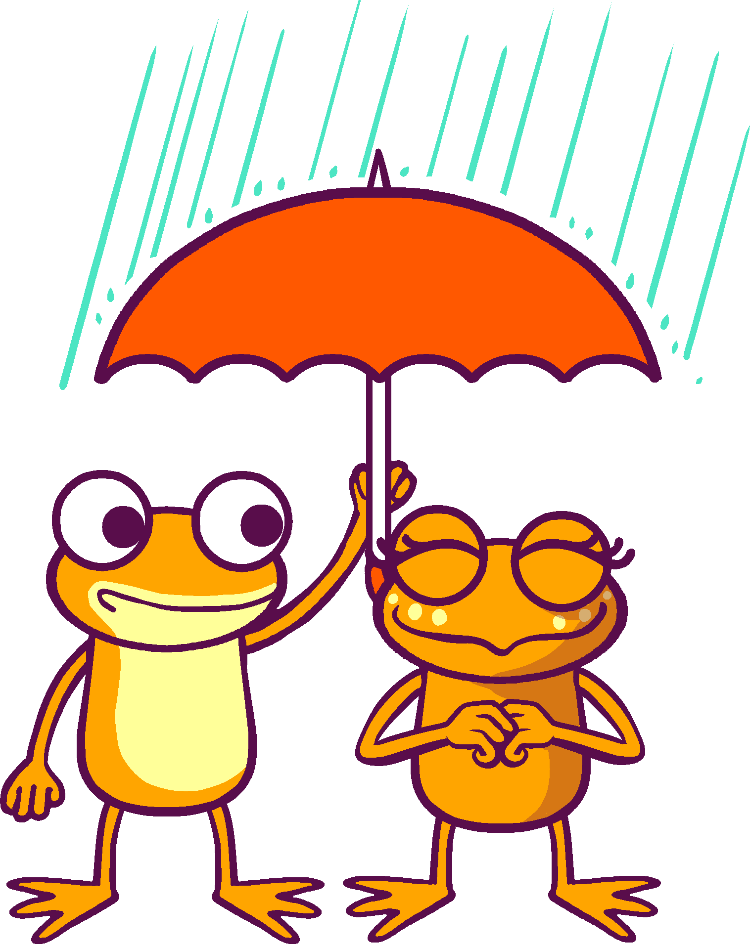

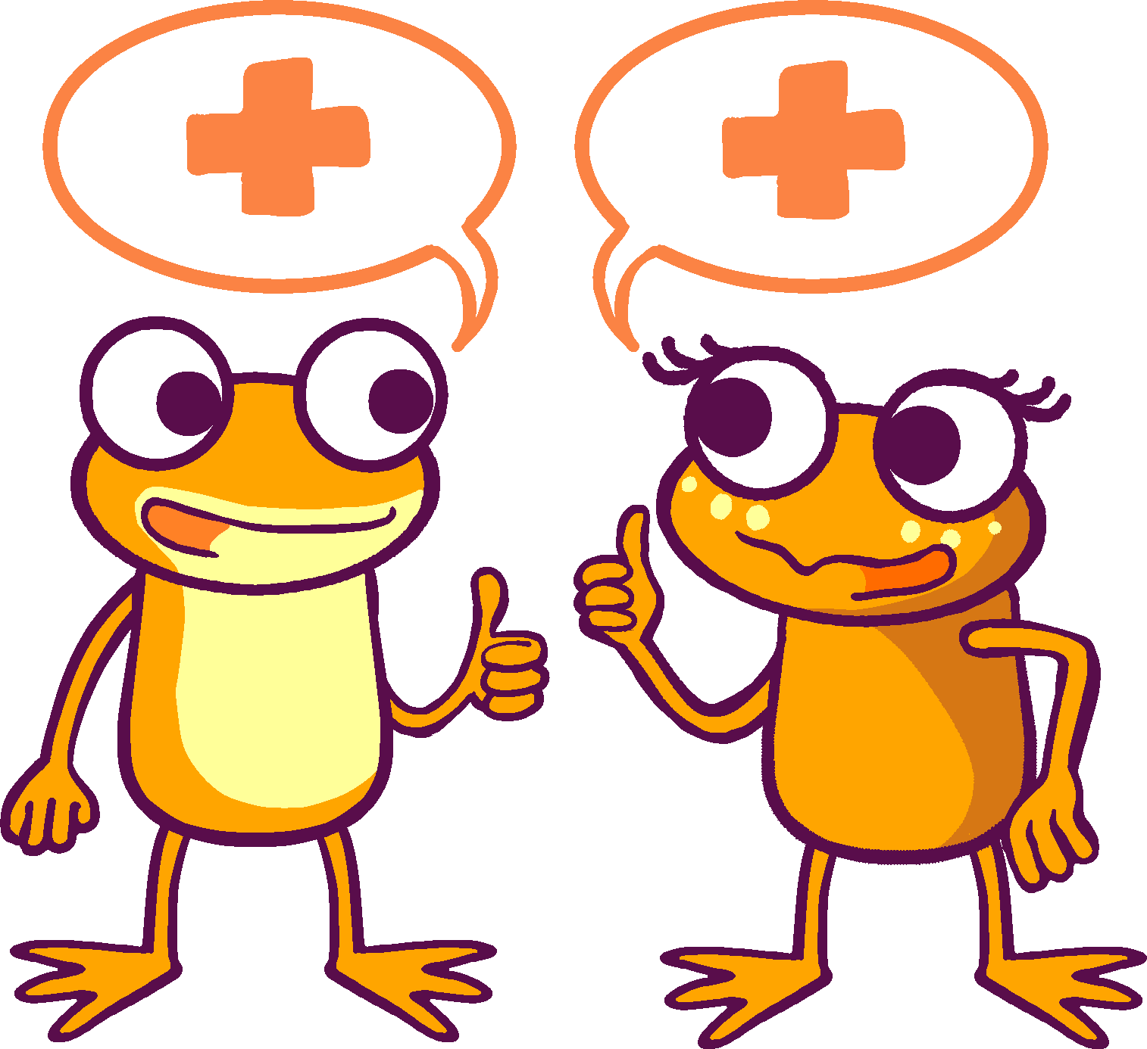

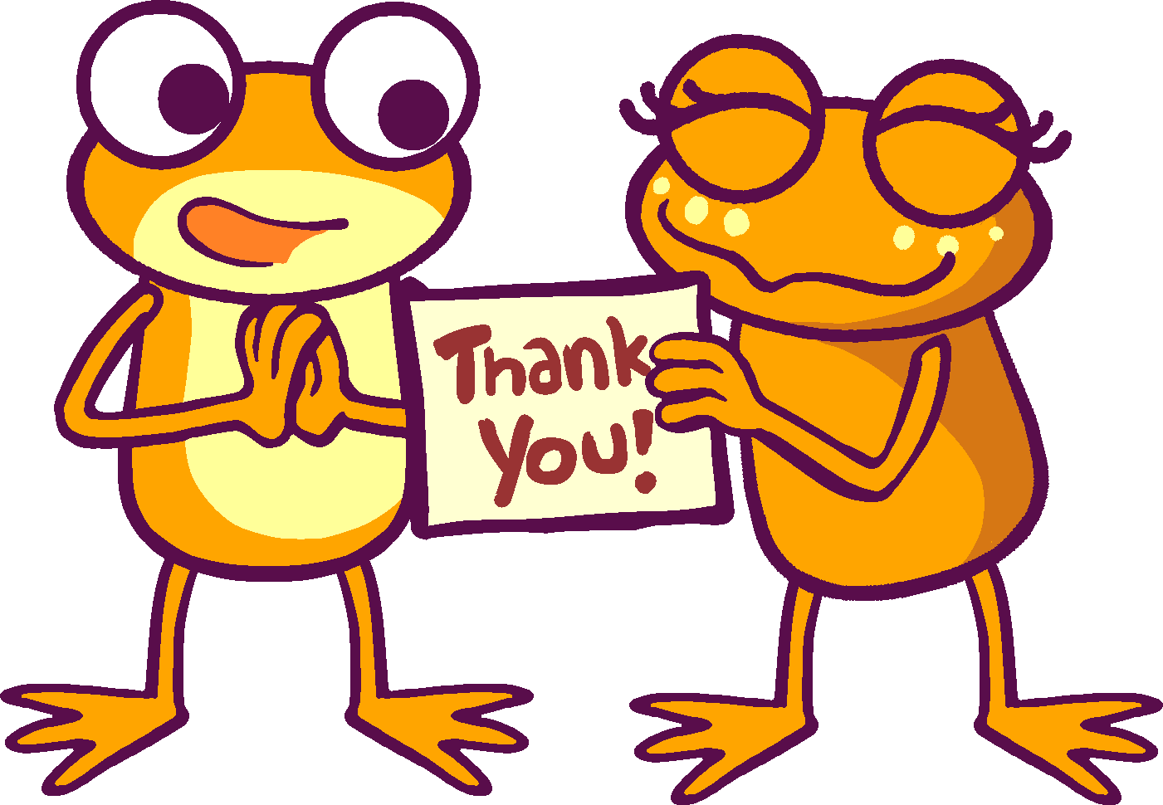
A
B
C
D
E

Slide 9
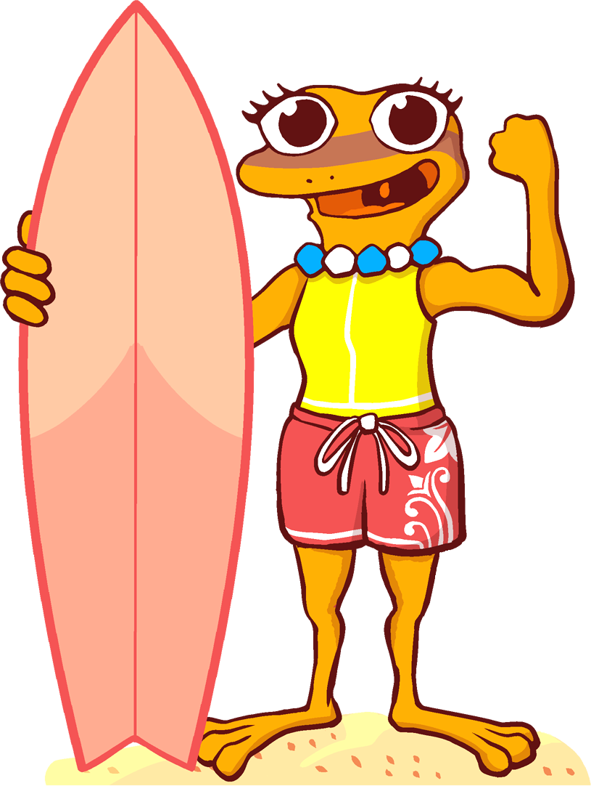
BONUS
Who did spark think was the prettiest frog around? What made her even prettier?
Fill in the blank: What you _____ and _____ matters.
True or False: Everyone has something unique about them. Why is it important to have something unique?

